Slide 1
Out-of-Class Assignment #1: Designing an Assessment
Found on Canvas
Type your answers directly into document
Upload to Canvas when completed
This is an independent assignment
Use what you have learned through the class case study to answer the questions.
You can start now and gradually answer the questions as the material is covered in class.
This assignment is worth 25 points. Points for each question are noted on the assignment. On-time submission earns 2 points.
2 points are deducted for each day late.
DUE: April 22, 2022 by 5:00 pm

Slide 2
Considerations for Choosing Assessment Tools:
Client’s chronological age
Client’s developmental level
Linguistic and cultural background
Clinical/Medical History
Client’s background and experiences
Talking with unfamiliar adults
School experience
Test taking behaviors
Looking at books/magazines
Pointing to pictures that “match what I say”
Describing pictures
Answering questions adults already know the answer to

Slide 3
Choosing Assessment Methods: How to answer your clinical questions
Informal Measures – Not standardized (e.g., speech sample, intelligibility rating)
Standardized Measures – Test takers answer same questions and are scored in a “standard” or consistent manner
Criterion-referenced – Compare performance to a set standard (e.g., rubric)
Norm-referenced – Compare performance against performance of peers
Standard score – Set of scores with same mean/SD to allow comparison
Standard deviation – Measures the amount of variation within a sample
Percentile rank – A score that indicates rank of individual compared to peers (e.g., same age, same grade)
Age Equivalency – Comparison score comparing client performance to specific age groups
Growth Scale Values – Tracks changes in performance over time
Notes:
The major purpose of standard scores is to place scores for any individual on any variable having any mean and standard deviation on the same standard scale so that comparisons can be made. Without some standard scale, comparisons across individuals and/or across variables would be difficult to make (Lomax,2001, p. 68). In other words, a standard score is another way to compare a student's performance to that of the standardization sample. A standard score (or scaled score) is calculated by taking the raw score and transforming it to a common scale. A standard score is based on a normal distribution with a mean and a standard deviation (see Figure 1). The black line at the center of the distribution represents the mean. The turquoise lines represent standard deviations.
On many standardized assessments the publishers base the standard score on a distribution with a mean of 100 and a standard deviation of 15. A score of 100 on such a test (e.g., WJIIIDRB) means that if the student scored in the middle of the distribution (Mercer & Pullen, 2009). A Standard Score of 85 indicates that the student scored one standard deviation below the mean of the normative sample. Figure 2 illustrates a normal distribution of test scores with a mean of 100 and a standard deviation of 15. The standard deviation is an indication of the variability of scores in a population (Mather & Jaffe, 2002).
The most common definition of a percentile is a number where a certain percentage of scores fall below that percentile. You might know that you scored 67 out of 90 on a test. But that figure has no real meaning unless you know what percentile you fall into. If you know that your score is in the 90th percentile, that means you scored better than 90% of people who took the test.
In statistics, the standard deviation (SD, also represented by the Greek letter sigma σ or the Latin letter s) is a measure that is used to quantify the amount of variation or dispersion of a set of data values.^{[1]} A low standard deviation indicates that the data points tend to be close to the mean (also called the expected value) of the set, while a high standard deviation indicates that the data points are spread out over a wider range of values.

Slide 4
Standard Scores and Standard Deviations
Percentages not percentiles
Don’t confuse them!

Slide 5
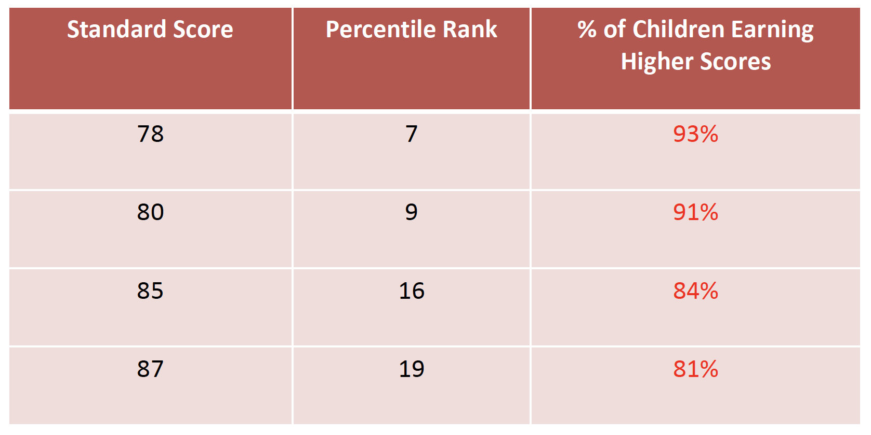
Eligibility versus Functional Impact
SS of 78 or lower usually a cutoff for service eligibility in K-12 setting

Slide 6
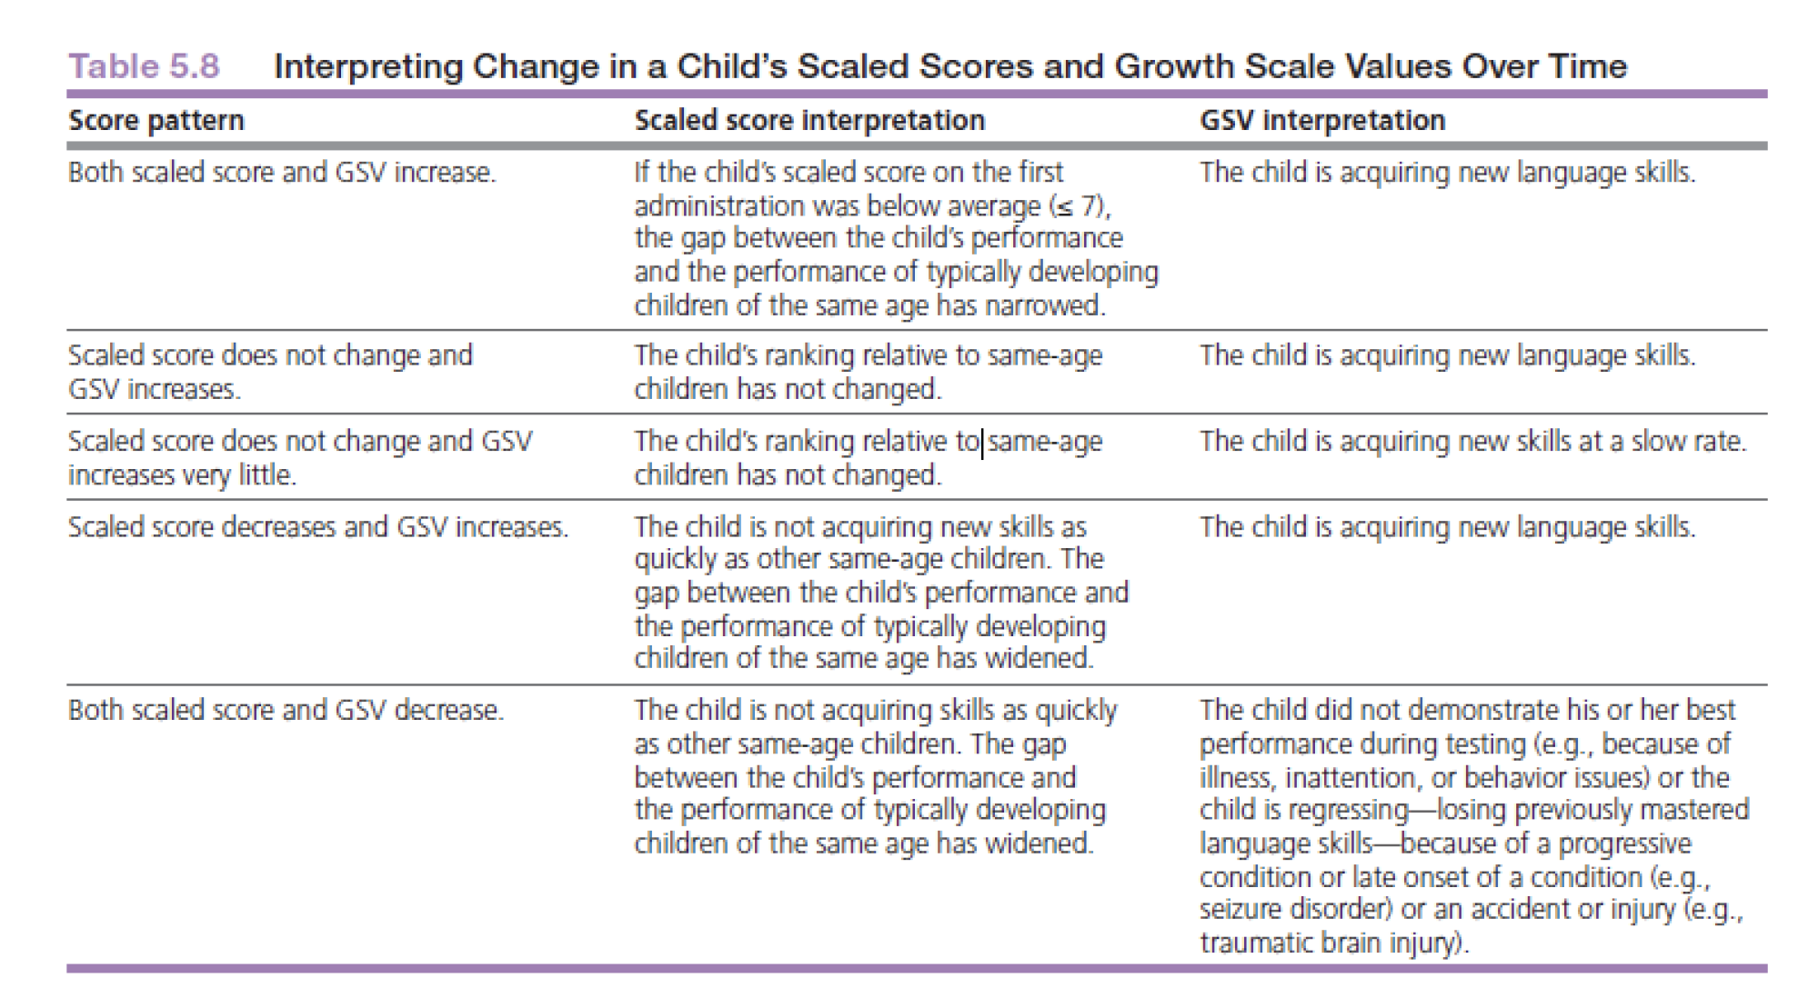
Example of SSs and GSVs on the CELF-P3
SS reflect comparison to others while GSV correspond to within or individual comparison to past performance

Slide 7
Age Equivalency
Average age in years and months typical for a given raw score.
DOES NOT provide information needed to determine if a child has a language impairment.
Although AE may be easier to understand for parents, it also can be misleading especially when discussing children with severe disabilities.

Slide 8
Planning and Preparing for a Successful Evaluation Session
Consider:
what you will do prior to the assessment (Group 1 & 7)
how you will greet client on first meeting (Group 2)
how you will prepare the room and materials (Group 3 & 9)
how you will manage behaviors during testing (Group 4 & 8)
how you will document client’s communication (Group 5)
how you will end your first session (Group 6 & 10)

Slide 9
Case Study: Introduction to Assessment Activities
Matthew attended three assessment sessions
The first session was conducted by Sara Starlin, SLP
The second and third sessions were conducted by Heather Moore, SLP.
Matthew was very attentive and cooperative during all sessions.

Slide 10
The Interview as a Diagnostic Tool
The interview is an important diagnostic tool
Parent is expert on child’s development over time and in various contexts
Especially important for children who do not fit the standardization sample or cannot participate in a traditional standardized assessment.
When should the interview occur?
Before and/or during the assessment.
Follow-up on intake information.
Avoid asking questions that have already been provided in paperwork.
Ask open-ended questions or provide prompts
Tell me about your concerns.
How does your child let you know what s/he wants?
Is there anything else that you want to make sure I know?
Do you feel your child’s communication during the assessment today was typical of what you see at home?
Be an active listener, restate, and ask for clarification

Slide 11
Activity #4: Watch a language sample and form your initial clinical impressions Individual Activity- read through the questions first
Video title: SSD 1 Matthew DX1 Language Sample
Questions to consider:
Does his speech sound intelligible?
Do his utterances sound age appropriate?
How is his ability to comprehend questions?

Slide 12
Clinical question | Measures
How significant is Matthew’s speech sound disorder? | DEAP (percentile from norm-referenced test)
How can we describe his speech sound disorder? What phonological patterns does he have in error? How intelligible is his speech? | DEAP (used descriptively- list of significant error patterns) Intelligibility (informal measure)
What kindergarten phonological awareness skills does he have? Does he know his letter sounds? Can he identify the first sound in words? Can he blend/segment words? | Letter Sound Probe (informal measure) Initial Sound ID Probe (informal measure) Blending/Segmenting Probes (informal measure)
What other factors may be contributing to his speech sound disorder? Hearing status? Oral motor skills? Overall Expressive Language Disorder Comprehension skills | Hearing Information (informal interview) Oral Motor Skills (clinical observation) Expressive language skills (clinical impression) CELF-P2 (percentile from a norm-referenced test)
What is the best treatment plan? What error patterns should be targeted first and what is Matthew’s baseline on those error patterns? What does the research say is the best approach for treating Matthew’s SSD? What are the family’s preferences concerning therapy? | Speech Sound Probes (informal measure) Research analysis (informal analysis) Family Preferences (informal interview)

Slide 13
Strategies for Eliciting a Language Sample
With children:
Staging environment
Open-ended questions
Motivating, interactive materials
Piece by piece
Sabotage
Turn-taking
With adults:
Open-ended questions
Personal narratives
Accounts
Scripts

Slide 14
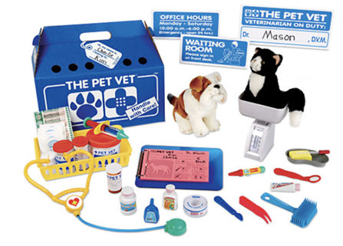
Eliciting Language Scenarios
You have the following toy set to use during your initial assessment with a child:
1.) How would present this toy to a child to elicit language?
2.) What actions can you take increase opportunities for child’s communication?
3.) What type of open-ended questions would you ask?
4.) Pros/cons for using toy?

Slide 15
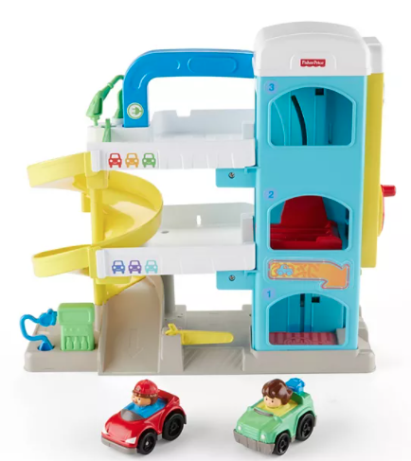
Eliciting Language Scenarios
You have the following toy set to use during your initial assessment with a child:
1.) How would present this toy to a child to elicit language?
2.) What actions can you take increase opportunities for child’s communication?
3.) What type of open-ended questions would you ask?
4.) Pros/cons for using toy?

Slide 16
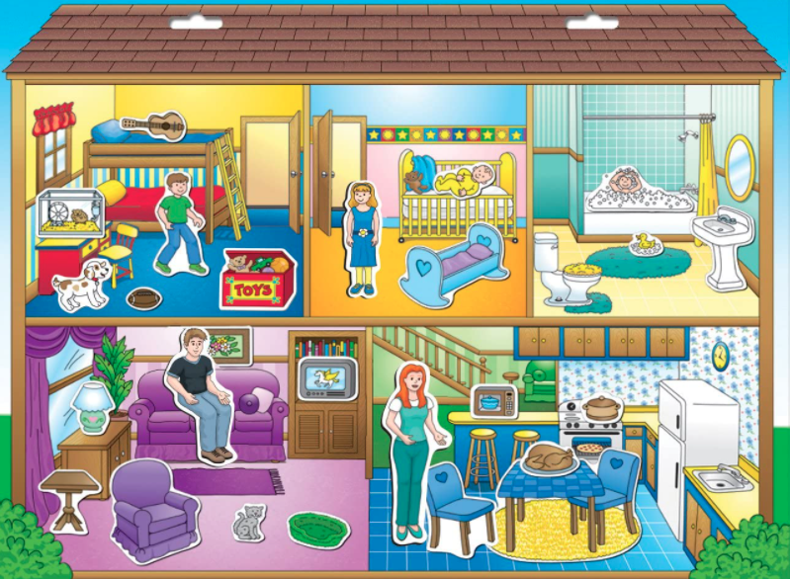
Eliciting Language Scenarios
You have the following toy set to use during your initial assessment with a child:
1.) How would present this toy to a child to elicit language?
2.) What actions can you take increase opportunities for child’s communication?
3.) What type of open-ended questions would you ask?
4.) Pros/cons for using toy?

Slide 17
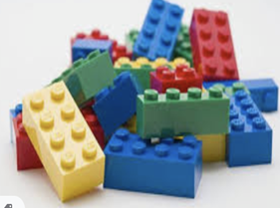
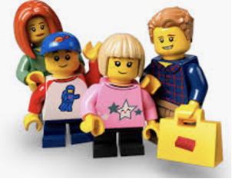
Eliciting Language Scenarios
You have the following toy set to use during your initial assessment with a child:
1.) How would present this toy to a child to elicit language?
2.) What actions can you take increase opportunities for child’s communication?
3.) What type of open-ended questions would you ask?
4.) Pros/cons for using toy?

Slide 18

Eliciting Language Scenarios
You have the following book to use during your initial assessment with a child:
1.) How would present this book to a child to elicit language?
2.) What actions can you take increase opportunities for child’s communication?
3.) What type of open-ended questions would you ask?
4.) Pros/cons for using book?

Slide 19

Eliciting Language Scenarios
What sort of items should go in a grab bag?
1.) How would present a grab bag to a child to elicit language?
2.) What actions can you take increase opportunities for child’s communication?
3.) What type of open-ended questions would you ask?
4.) Pros/cons for using grab bag?

Slide 20


Eliciting Language Scenarios
You are doing a teletherapy assessment. You have the Imagistory app on your iPad and can share your screen. This app includes wordless picture stories. Even if you haven’t used the app, consider how you might present this wordless story through Zoom; the actions you can do to increase opportunities for child’s communication; the comments or language modelling you might do; and open-ended questions you might ask.
1.) How would you present the app?
2.) What open-ended questions would you ask?
3.) Pros/cons for using this app

Slide 21
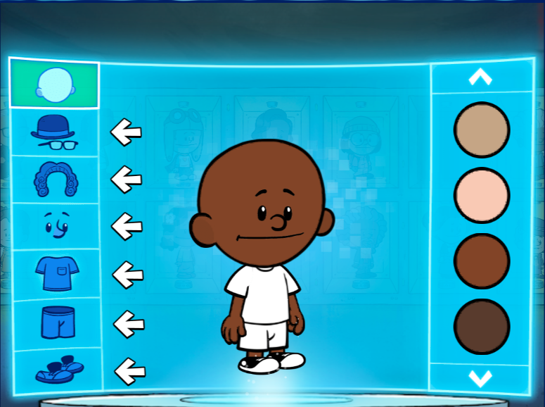
Eliciting Language Scenarios
You are doing a teletherapy assessment. You found this hero builder game at
https://pbskids.org/xavier/games/hero-maker.
In this game, the child chooses colors, features, and clothes to design the hero. How might you use this game to elicit a language sample.
1.) How would you present the app?
2.) What open-ended questions would you ask?
3.) Pros/cons for using this app

Slide 22
Summary of Language Sampling Strategies
Choose Materials that:
are culturally diverse and represent the child’s home.
are appropriate for the developmental age of client.
have pieces that can be manipulated, requested and talked about.
match the client’s interests, but be wary of obsessions
allow for turn-taking
can be sabotaged (missing pieces, pieces that are broken)
have choices
are small enough to be hidden in a bag/box/pocket and brought out as a surprise
can be used in short repeatable routines, e.g., bubbles (open, get wand, shut bottle, blow, pop)
elicit a variety of communicative functions (request, label, comment, describe, question, explain, direct)

Slide 23
Summary of Language Sampling Strategies
Clinician Strategies:
Manage access to the toys and pieces of the toys. Within sight, but out of reach.
Script out what you will say and what the client might say for the toys you’ll present.
Model playing with the toy and talking about what you are doing
Offer one piece of the activity at a time (requesting, describing)
Take turns. Have child tell you what to do.
Ask clients to show/teach you how to do something or use a toy that they brought.
Do something unusual or make a mistake that might surprise the client and prompt a comment
Use open-ended questions, comments, and expectant pausing
Engage with the child’s pretend play and introduce conversation, e.g., crash a car into the client’s car. Pause, wait for a response. Comment: “Oh no, my car is broken.”
Sabotage the activity – give a piece different from what child requested; give a wrong piece (e.g., puzzle piece from a different puzzle, dinosaur for a farm set), give a broken piece

